Slide 1
Interior and Exterior Contributions to Transfer Cross Sections
DREB12, Pisa
Ian Thompson, LLNL
Akram Mukhamedzhanov, Texas A&M
Jutta Escher, LLNL
TORUS Collaboration.
March 26, 2012

Slide 2
The Debate: Surface or Volume?
Do transfer or knockout experiments measure surface properties (ANC, reduced width), or
volume properties (norm of overlap function) ?
Theory: only ‘asymptotic properties’ are observable: invariant under off-shell (interior) unitary transformations.
Reply: We have relied on local potentials for interior forms
Conclusion: We must:
  pay attention to invariance if we derive effective potentials
  (which may be local or non-local)
  separate the contributions from interior and exterior
  see if/how these contributions depend on higher-order couplings.

Slide 3
Transfers to Resonances?
Not clear what do we measure when we compare
  (a) experimental magnitude to theory magnitude?
  (b) experimental width to theory width?
Need a new general theory for resonant transfers!
  Preferably one easy to calculate!
  At present, to get convergence at large radii:
  we use bins, or complex contour, or damping
  Should calculate actual shape of resonance peak
    Include wide / overlapping / multichannel resonances
    Ideally should fit using R-matrix resonance parameters

Slide 4
New work
A.M. Mukhamedzhanov, PRC 84, 044616 (2011)
Look at dependence of transfer rate on r_{nA}
  = radius of neutron wave function φ_{n}(r_{nA}) being probed
  Remember that φ_{n}(r_{nA}) for r_{nA} > r_{s} (surface radius)
  depends on the reduced width: γ² or the ANC: C
Look at how post and prior transfers depend on maximum value of r_{nA} (cut wfn to zero outside).
Later, try to express as much of the transfer as possible in terms of the γ².
This will help calculation of transfers to resonances
  Needed e.g. for Trojan Horse methods, and many expts.

Slide 5
Post and Prior DWBA Transfer Couplings
Consider a deuteron d=n+p incident on target A, and the A(d,p)B reaction, with B=A+n.
Binding potentials V_{np} for φ_{d}(r), V_{nA} for φ_{n} (r_{nA})
  Entrance & exit optical potentials U_{dA}(R), U_{pB}(R)
  Also need ‘core-core’ potential U_{pA}
Look at DWBA as first approximation:
  T_{post} = <f_{p}⁽⁻⁾ φ_{n} | V_{np} + U_{pA} - U_{pB}(R) | φ_{d} f_{d}⁽⁺⁾>
    As long-ranged in r_{nA} as φ_{n}, as V_{np} acts at all distances from target
  T_{prior} = <f_{p}⁽⁻⁾ φ_{n} | V_{nA} + U_{pA} - U_{dA}(R) | φ_{d} f_{d}⁽⁺⁾>
        Short-ranged in r_{nA} than φ_{n}, as V_{nA} , U_{pA} , U_{dA} all cut off away from target
(has ZR limit)

Slide 6
Effects of limiting max r_{nA}
Bound state
Resonance bin at 1 MeV
Peak cross sections, calculated in the post and prior formalisms, are shown as a function of the cutoff radius,
(beyond which contributions from the neutron wave function are set to zero)
The cross sections are normalized relative to the peak cross sections obtained in the full calculation.
See that Post contributions are from large neutron radii.
Convergence to resonances is slow (especially for post form)
Very small post contributions from the interior

Slide 7
‘Surface Amplitude’ component
Define T_{post}(a,b) & T_{prior}(a,b) with a < r_{nA}< b limits
Mukhamedzhanov (PRC 84, 044616, 2011) showed recently:
T = T_{post}(0,a) + T_{surf}(a) + T_{prior}(a,∞)
where T_{surf}(a) = <f_{p}⁽⁻⁾ φ_{n} | | φ_{d} f_{d}⁽⁺⁾>_{(in)}
Evaluate:

Slide 8
T = T_{post}(0,a) + T_{surf}(a) + T_{prior}(a,∞)
Prove post-prior equivalence in DWBA:
If a=0, then, since T_{surf}(0) = 0, find T = T_{prior}(0,∞)
If a=∞, then, since T_{surf}(∞) = 0, find T = T_{post}(0,∞)
Dependence on reduced width γ² of neutron wf:
If a is outside radius of the potential, then
T_{surf}(a) + T_{prior}(a,∞) depend on wfn only by γ²
Only dependence on interior is by (small) T_{post}(0,a)

Slide 9
Size of the Surface Term
Bound state
Resonance
T_{surf}(a) = T_{prior}(0,a) - T_{post}(0,a)
Now we see the surface term peaked at the surface (as expected).
But it does not produce all the cross section peak, or all the integral

Slide 10
CDCC Breakup exterior calculations
  The potentials in the prior matrix element
  V_{n} + U_{pA} - U_{d}(R)
  are very similar to the
  U_{nA} + U_{pA} - U_{d}(R)
  used in CDCC breakup calculations.
  Difference is that V_{n} = binding potl and U_{nA} = optical potl.
  If we can ignore this difference, and calculate Ψ^{CDCC}, then the ‘exterior prior’ term disappears:
  T = T^{CDCC}_{post}(0,a) + T^{CDCC}_{surf}(a)
  For now:
  regard the ‘exterior prior’ as indicator of breakup.

Slide 11
Interior / Surface / Breakup
Interior wfn
contribution
inside x-axis radius
Breakup
outside
radius
on x-axis
Surface
term at
x-axis radius
Plotting sqrt(cross-section) – to estimate amplitudes

Slide 12
Predictions for future CDCC-surface calculations
T^{CDCC}_{surf}(a) = T - T^{CDCC}_{post}(0,a)
≈ T_{post}(a,∞) -- use this to estimate:
Black curve ratio of post cross sections σ_{post}(a,∞)/σ = |T_{post}(a,∞)/T|^{2 :}
Ratio of cross section peaks
Try to choose radius around 7.5 – 8 fm
outside potential, where the CDCC-surface
contribution is complete
Larger interior contribution
for this bound-state transfer

Slide 13
Conclusions
See development of a model that separates
  Interior contributions from shape of wave function
  Breakup contributions from exterior tails
  Dominant ‘surface contribution’ from exterior tails.
‘Surface Approximation’: if neglect other terms
Good prospects for
  a new model of transfer reactions to resonances, that
  uses small-radius calculations (convergent!),
  to map R-matrix parameters onto resonance shapes.
We are now developing the CDCC approach
In future: fit neutron R-matrix parameters from expt.

Slide 14
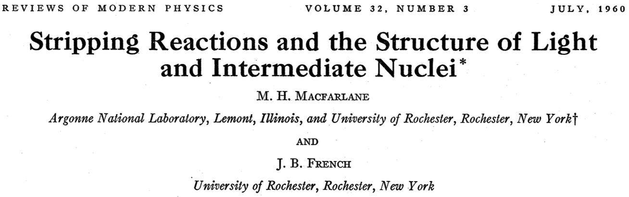
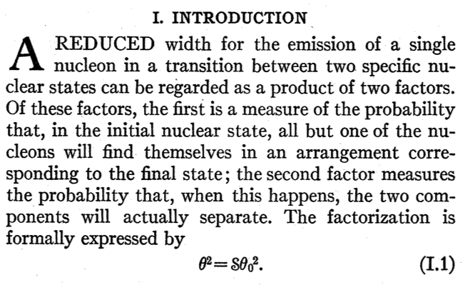
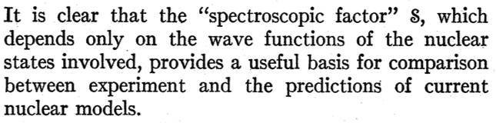
Some history from 1960:
Transfers measure reduced widths
Define ‘spectroscopic factor’ S
= ratio of observed reduced width
to that of single-particle state
Maybe something for us to learn here?

Slide 15
TORUS
Theory of Reactions of Unstable Isotopes
DOE Topical Collaboration
Ian Thompson, LLNL
Jutta Escher, LLNL
Filomena Nunes, MSU
Neelam Upadhyay (PD)
Akram Mukhamedzhanov (TAMU)
V. Eremenko (PD)
Charlotte Elster (OU)
Goran Arbanas (ORNL)
Aim: develop new methods that will advance nuclear reaction theory for unstable isotopes by using three-body techniques to improve direct-reaction calculations
Year 2 out of 5.

