Slide 1
Status of reaction theory for studying rare isotopes
Filomena Nunes
Michigan State University
Varena, June 2012

Slide 2
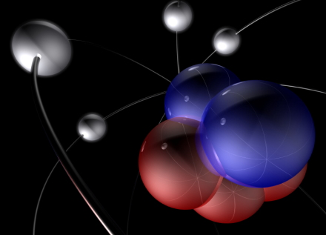
what are we after?
Unified description of nuclei and their reactions
Why is matter stable?
Effective NN force?
Limits of stability?
Shell evolution?
Deformation?
Clusterization?
Decay modes?
…

Slide 3

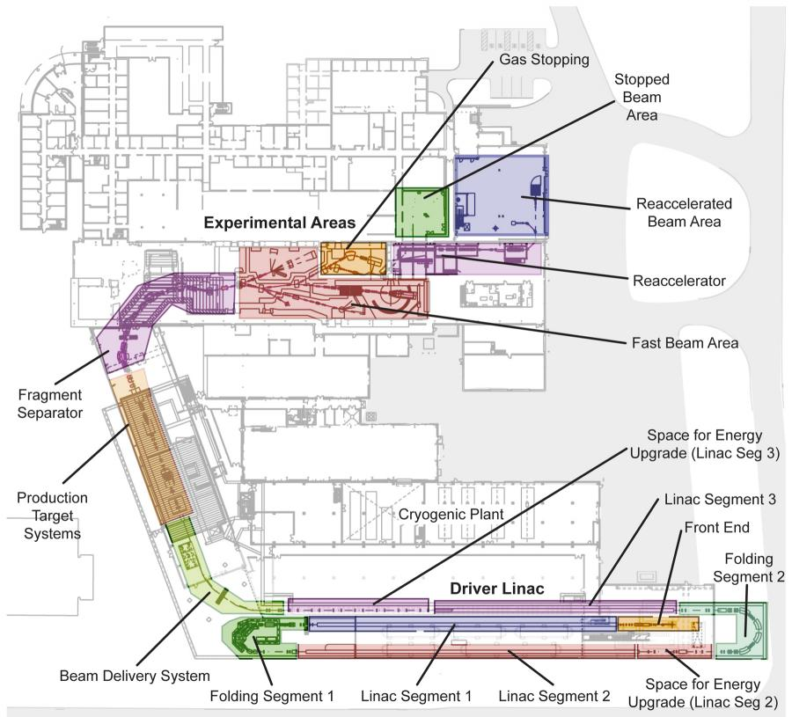


Facility for rare isotope beams FRIB

Slide 4
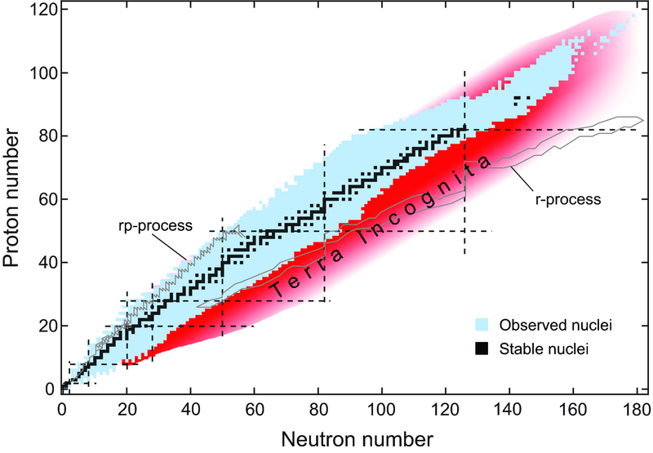
nucleosynthesis in the nuclear chart

Slide 5
what are we after?
Unified description of nuclei and their reactions
Why is matter stable?
Reaction probes
need reliable reaction theory!

Slide 6
Overview
  deuteron induced reactions – testing different models
  error bars on the analysis of (d,p) data
  heavy ion breakup – testing different models
  the ratio method

Slide 7
reducing the many body to a few body problem
isolating the important degrees of freedom in a reaction
keeping track of all relevant channels
connecting back to the many-body problem
effective nucleon-nucleus interactions (or nucleus-nucleus)
(energy dependence/non-local?)
many body input (often not available)
reliable solution of the few-body problem

Slide 8
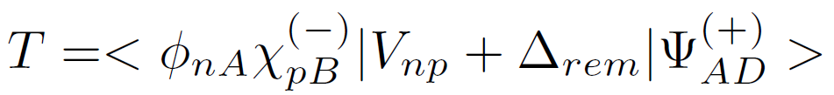
(d,p) reactions: three body model
r
n
p
R
Start from a 3-body Hamiltonian
A
Solve for 3B wfn and use in exact T-matrix

Slide 9
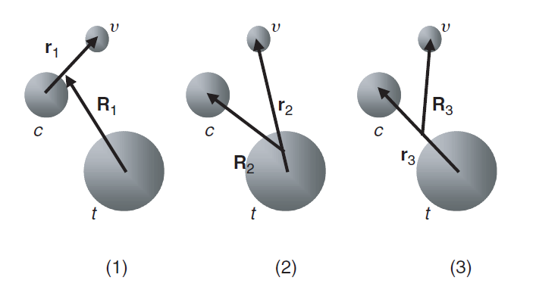
differences between three-body methods
Faddeev AGS:
all three Jacobi components are included
elastic, breakup and rearrangement channels are fully coupled
computationally expensive
Deltuva and Fonseca, Phys. Rev. C79, 014606 (2009).
3 jacobi coordinate sets
CDCC:
only one Jacobi component
elastic and breakup fully coupled (no rearrangement)
computationally expensive
Austern, Kamimura, Rawistcher, Yahiro et al.

Slide 10
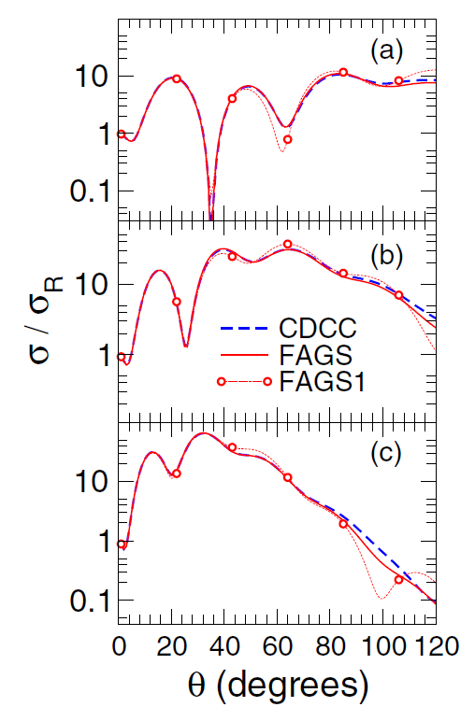
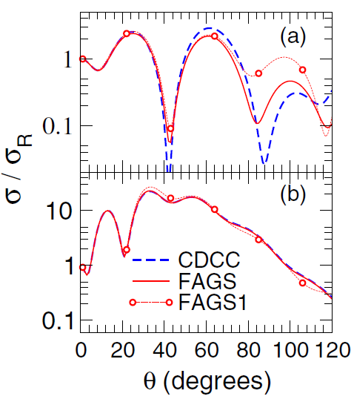
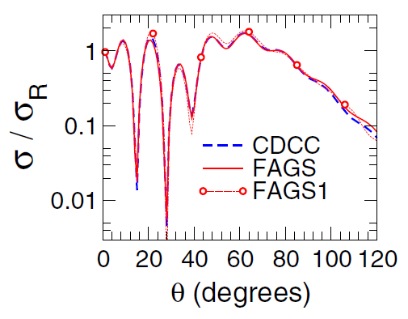
elastic scattering: comparing CDCC with Faddeev
d+¹⁰Be
d+¹²C
21.4 MeV
12 MeV
d+⁴⁸Ca
40.9 MeV
56 MeV
56 MeV
71 MeV
Upadhyay, Deltuva and Nunes, PRC 85, 054621 (2012)

Slide 11
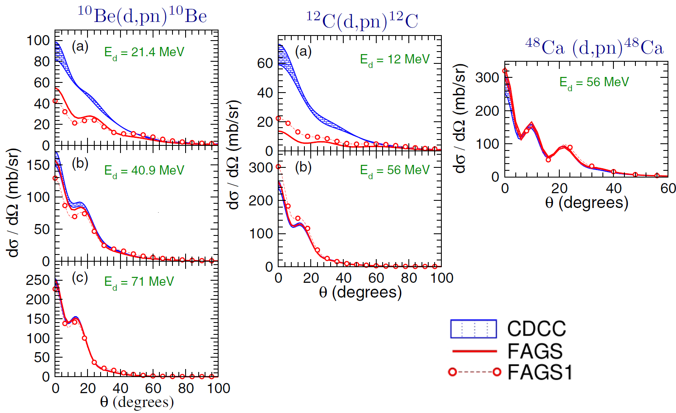
breakup: comparing CDCC with Faddeev
Upadhyay, Deltuva and Nunes, PRC 85, 054621 (2012)

Slide 12
breakup: comparing CDCC with Faddeev
Upadhyay, Deltuva and Nunes, PRC 85, 054621 (2012)

Slide 13
(d,p) reactions: three body model
r
n
p
R
Start from a 3-body Hamiltonian
A
Solve for 3B wfn and use in exact T-matrix

Slide 14

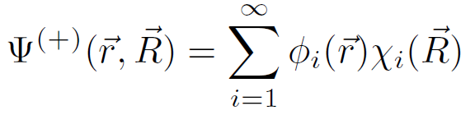
ADWA: Johnson and Tandy theory
Expand 3-body wfn in deuteron Weinberg states
set of scattering coupled channel equations
Johnson and Tandy potential
)
If only first term of the expansion is included:
coupled equations reduce to single channel!
[Johnson and Tandy, NPA 235, 56(1974)]

Slide 15
differences between three-body methods
Faddeev AGS:
all three Jacobi components are included
elastic, breakup and rearrangement channels are fully coupled
computationally expensive
Deltuva and Fonseca, Phys. Rev. C79, 014606 (2009).
3 jacobi coordinate sets
CDCC:
only one Jacobi component
elastic and breakup fully coupled (no rearrangement)
computationally expensive
Austern, Kamimura, Rawistcher, Yahiro etc, Prog. Theo. Phys (1986)
ADWA:
only one Jacobi component
elastic and breakup fully coupled (no rearrangement)
adiabatic approximation for breakup
only applicable to obtain transfer cross sections
runs on desktop – practical
Johnson and Tandy NP (1974)

Slide 16
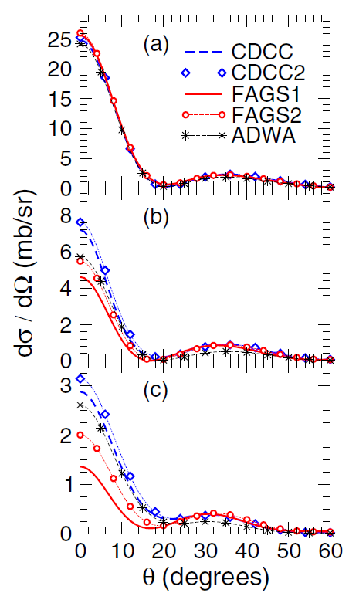
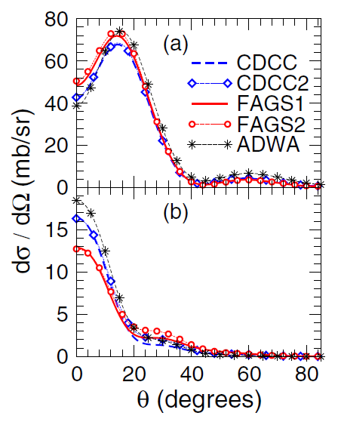
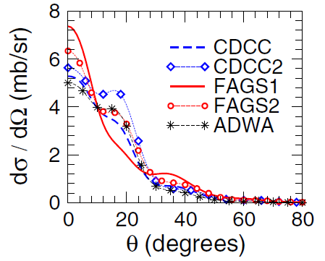
transfer (d,p): comparing ADWA, CDCC & Faddeev
¹⁰Be(d,p) ¹¹Be(g.s.)
¹²C(d,p) ¹²C(g.s.)
12 MeV
21.4 MeV
40.9 MeV
56 MeV
⁴⁸Ca(d,p) ⁴⁸Ca(g.s.)
56 MeV
71 MeV
PRC 84, 034607(2011), PRC 85, 054621 (2012)

Slide 17
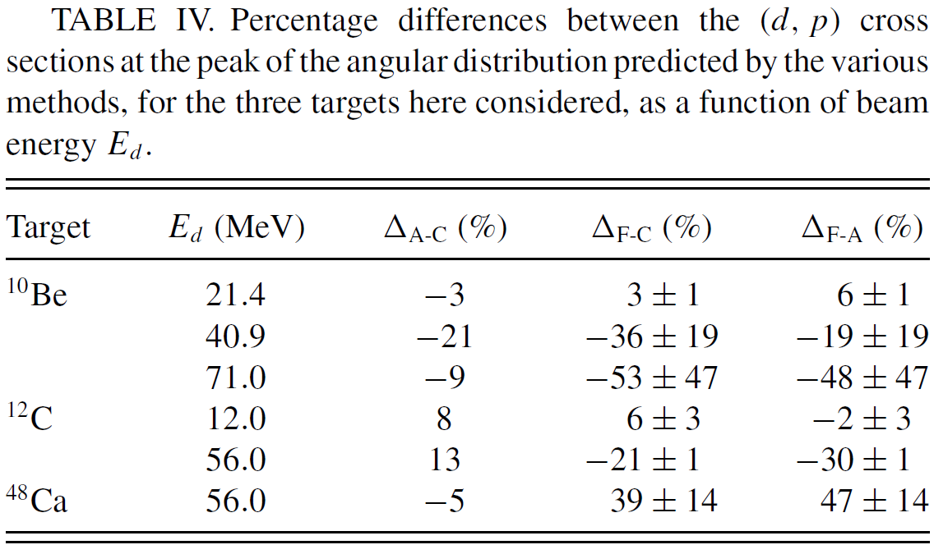
transfer: comparing ADWA, CDCC & Faddeev
Upadhyay, Deltuva and Nunes, PRC 85, 054621 (2012)

Slide 18
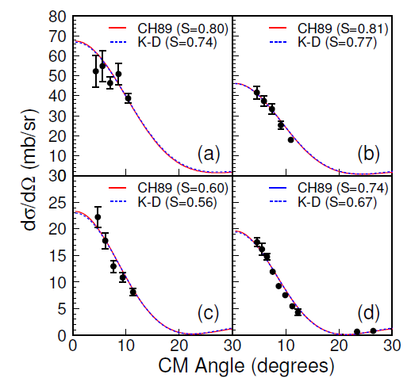
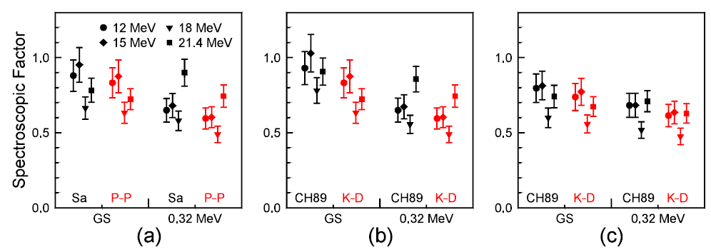
transfer: DWBA versus ADWA
¹⁰Be(d,p)¹¹Be @ 12-21 MeV
DWBA
entrance channel
DWBA
exit channel
ADWA
Schmitt et al, PRL 108, 192701 (2012)

Slide 19
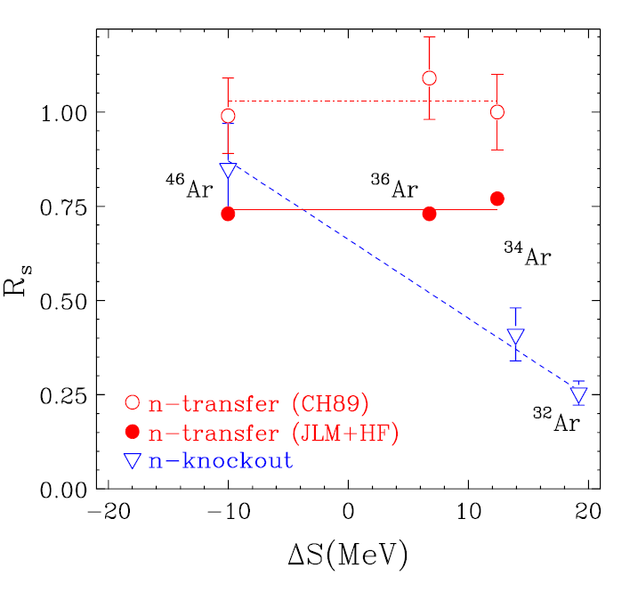
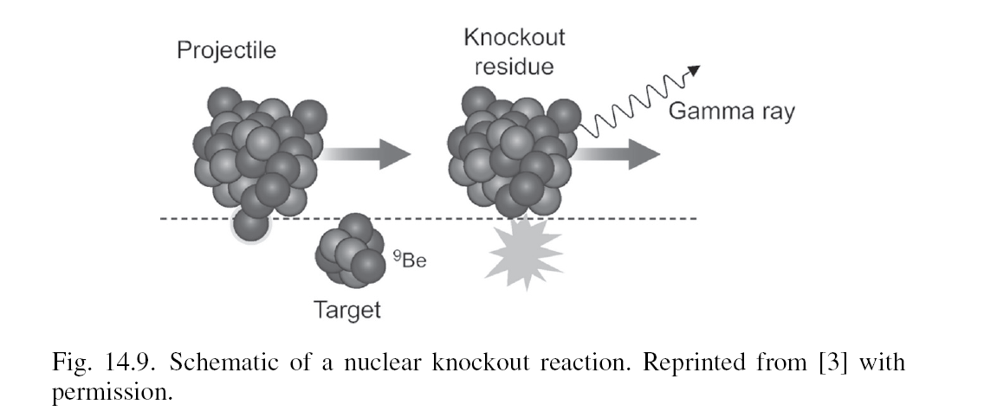
error bar on extracted structure from theory
[Jenny Lee et al, PRL 2009]
[Gade et al, PRL 93, 042501]

Slide 20
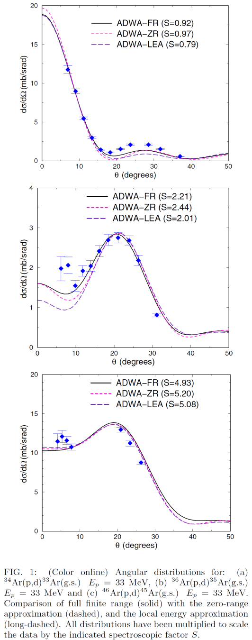
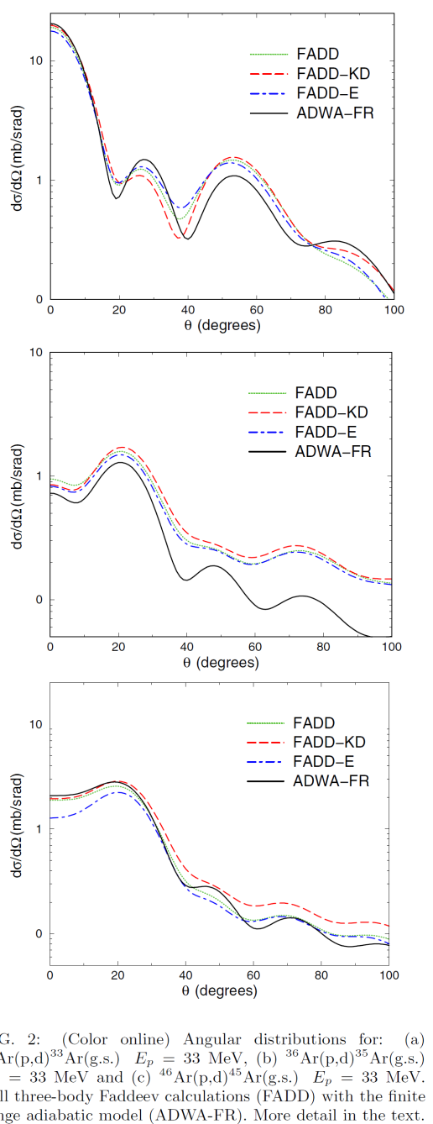
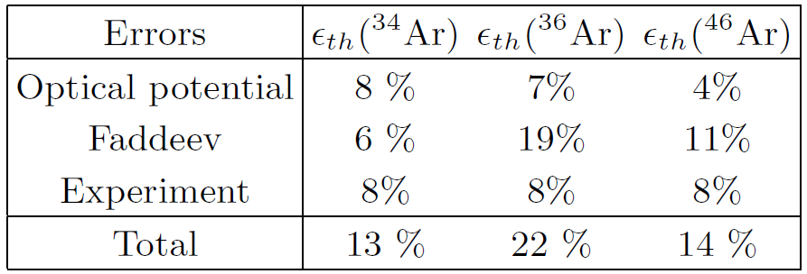
transfer data for Ar isotopes
finite range adiabatic methods are used to obtained spectroscopic factors
Faddeev calculations are used to determined error in reaction theory
[FN, Deltuva, Hong, PRC83, 034610 (2011)]

Slide 21
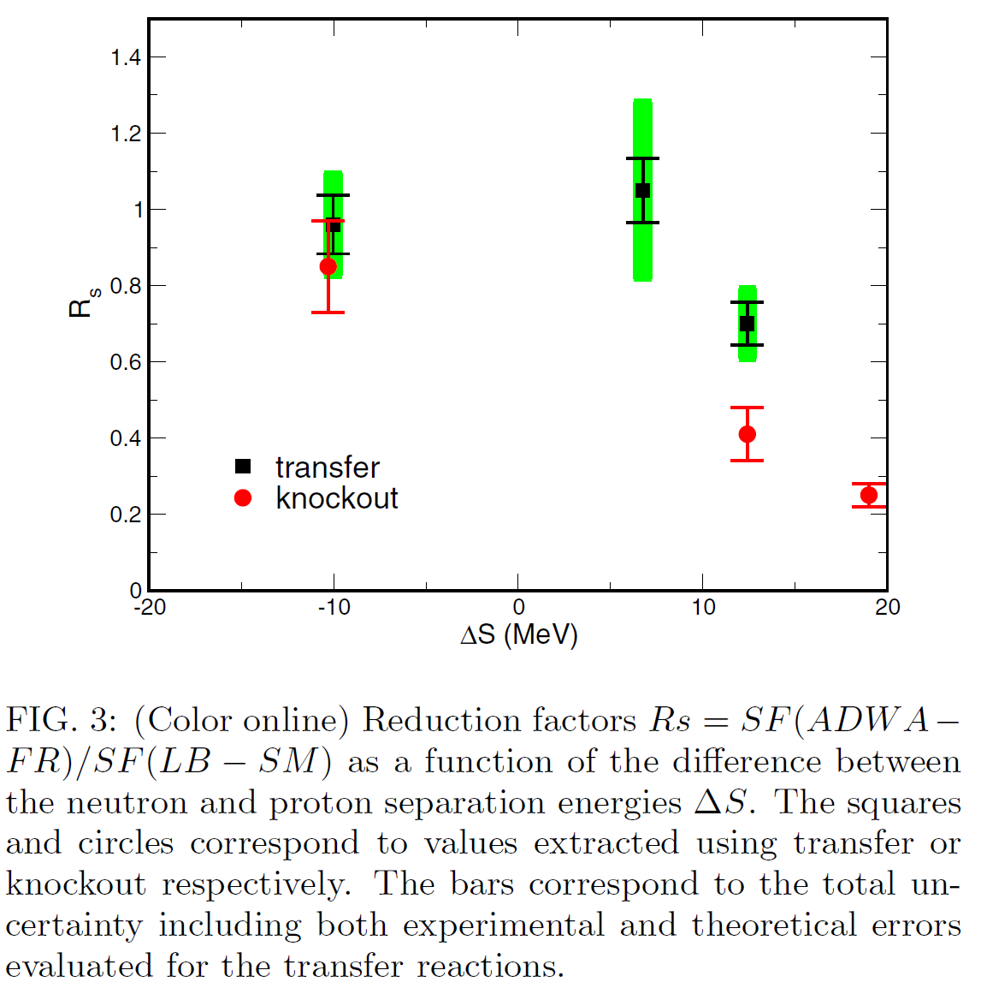
transfer versus knockout
[Jenny Lee et al, PRL 2009]
[Gade et al, Phys. Rev. Lett. 93, 042501]
[FN, Deltuva, Hong, PRC83, 034610 2011]

Slide 22
Conclusions CDCC/ADWA versus Faddeev
  Breakup with CDCC (d,pn)
  good agreement at E>20 MeV/u
  poor convergence at lower energies
    CDCC does not describe some configurations
  Transfer with ADWA or CDCC (d,p)
  good agreement around 10 MeV/u
    agreement for ADWA best for l=0 final states
  deteriorates with increasing beam energy
  ambiguities in optical potentials have larger impact at higher E

Slide 23
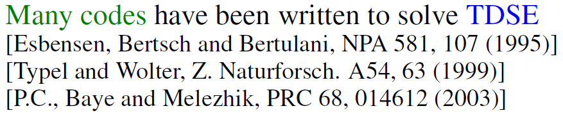

Heavy ion breakup
CDCC:
elastic and breakup fully coupled (no rearrangement)
computationally expensive
EXACT
TDSE: (time dep Schrodinger Eq)
classical trajectory, lack quantum interferences
runs on desktop
DEA: (dynamical eikonal approximation)
  improves TDSE by including quantal interferences
  improves eikonal by including dynamical effects
  runs on desktop – although can take days
Capel, Esbensen, Nunes, PRC(2011)

Slide 24

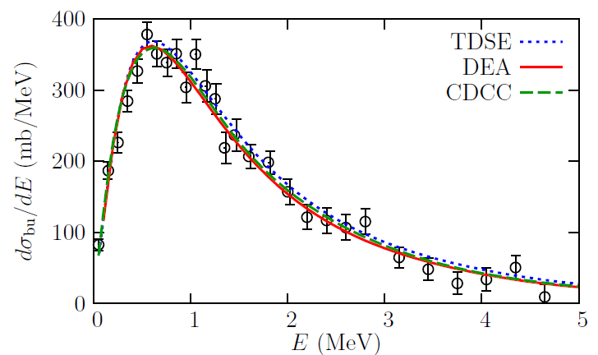
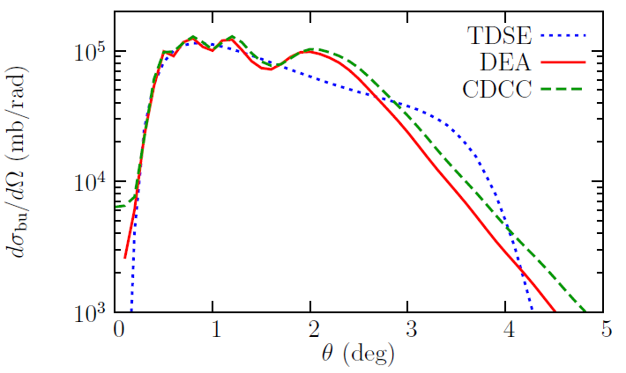
comparison of breakup methods
Data: Nakamura et al, PRC 79, 035805
Capel, Esbensen, Nunes, PRC (2011)

Slide 25
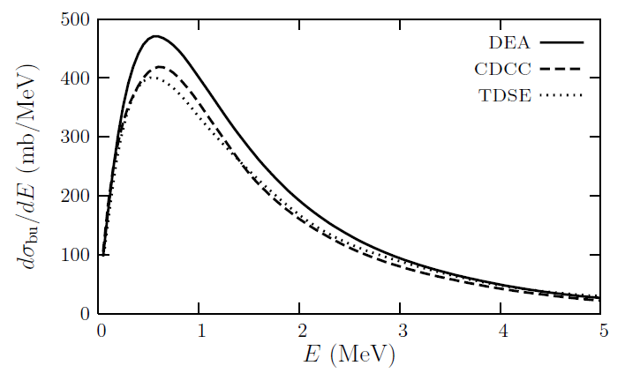

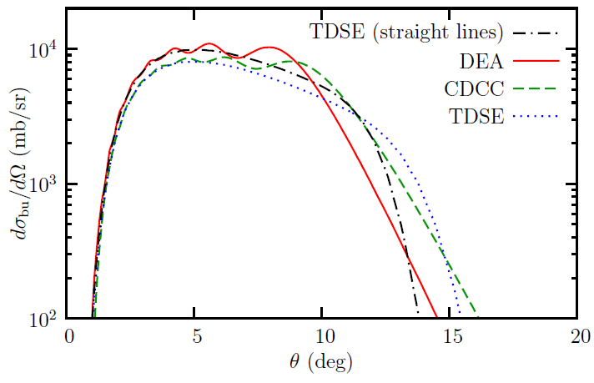
comparison of breakup methods
Capel, Esbensen, Nunes, PRC (2011)

Slide 26
breakup w CDCC/DEA/TDSE: conclusions
at high energy methods agree in energy distribution
  TDSE lacks quantum interference – ang distrubution
  DEA can replace CDCC to better than 1% at forward angles
at lower energy (around 20 AMeV)
  10-15% differences in peak of energy distribution
  larger differences in angular distributions
  neither DEA nor TDSE are reliable
all depend on core-target interactions (usually unknown)
Capel, Esbensen, Nunes, PRC (2011)

Slide 27
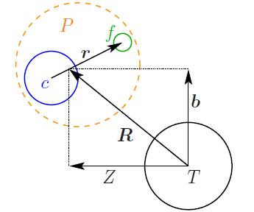



the ratio method for neutron halos
motivation: recoil excitation breakup model
neglects n-T interaction
adiabatic approximation
n
R. Johnson et al., PRL 79, 2771 (1997)
point-like elastic distribution
depending on V_{core-target}
Capel, Johnson, Nunes, PLB (2011)

Slide 28

the ratio method for neutron halos
motivation: recoil excitation breakup model
neglects n-T interaction
adiabatic approximation
n
R. Johnson et al., PRL 79, 2771 (1997)
no dependence on V_{core-target}
Capel, Johnson, Nunes, PLB (2011)

Slide 29


the ratio method for neutron halos
realistic calculations: DEA
includes n-T interaction
no adiabatic approximation
n
Capel, Johnson, Nunes, PLB (2011)

Slide 30

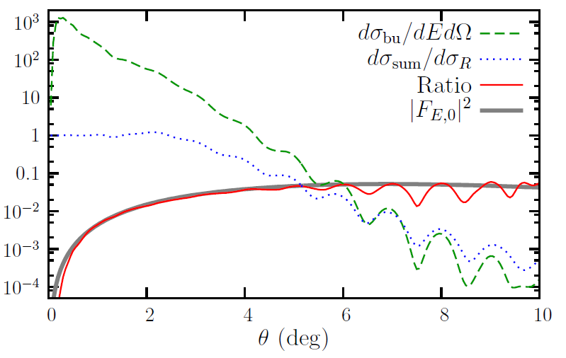
the ratio method for neutron halos
Capel, Johnson, Nunes, PLB (2011)

Slide 31
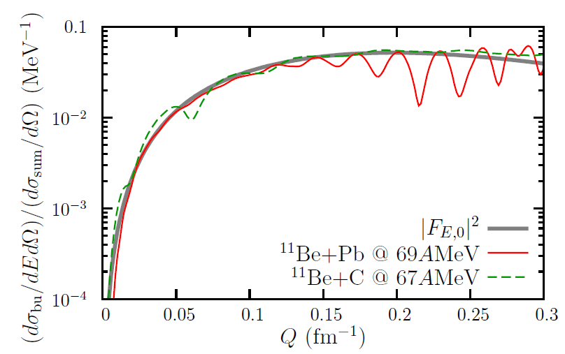
the ratio method for neutron halos
removes dependence on reaction mechanism altogether!
Capel, Johnson, Nunes, PLB (2011)

Slide 32
ratio method: conclusions
removes ambiguity in core-target opt. pot.
independent of reaction mechanism
probes halo wavefunction
  binding energy
  angular momentum
  more detail in wfns
possible extensions to be explored
    proton halos?
    two neutron halos?
    application to others fields?
Capel, Johnson, Nunes, PLB (2011)

Slide 33

thankyou!
our group at MSU: Ngoc Nguyen, Muslema Pervin,
Luke Titus, Neelam Upadhyay
collaborators:
June Hong(MSU), Arnas Deltuva (Lisbon),
TORUS collaboration: Charlotte Elster (Ohio),
Akram Mukhamedzhanov (Texas A&M),
Ian Thompson (LLNL), Jutta Escher (LLNL)
and Goran Arbanas (ORNL)
Antonio Fonseca (Lisbon), Pierre Capel (Brussels)
Ron Johnson and Jeff Tostevin (Surrey),
This work was supported by DOE-NT, NNSA and NSF

Slide 35
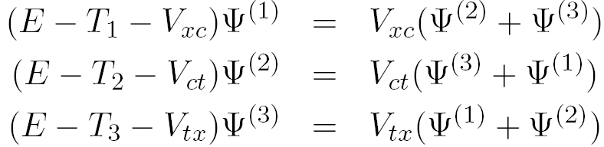
reaction methods: CDCC versus Faddeev formalism
CDCC Formalism
Faddeev Formalism

Slide 36
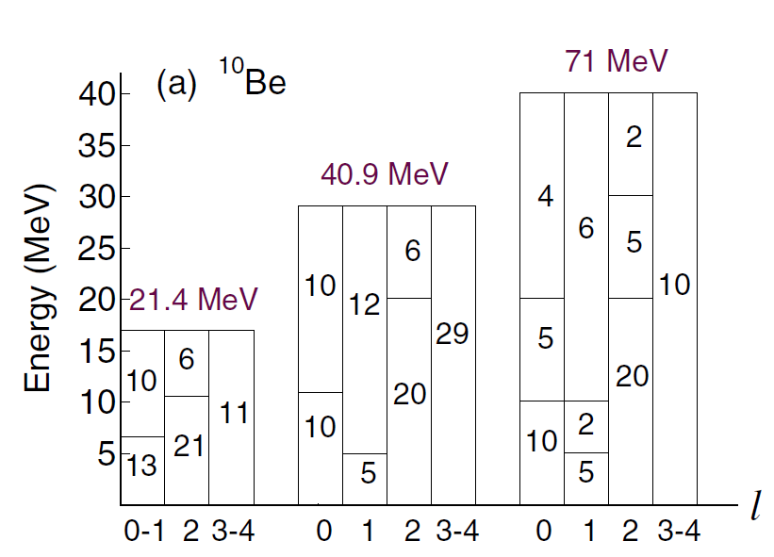
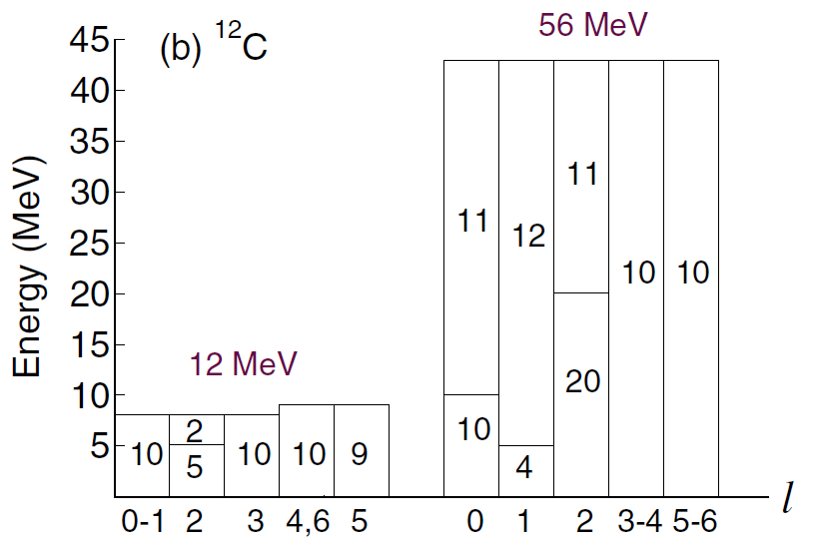
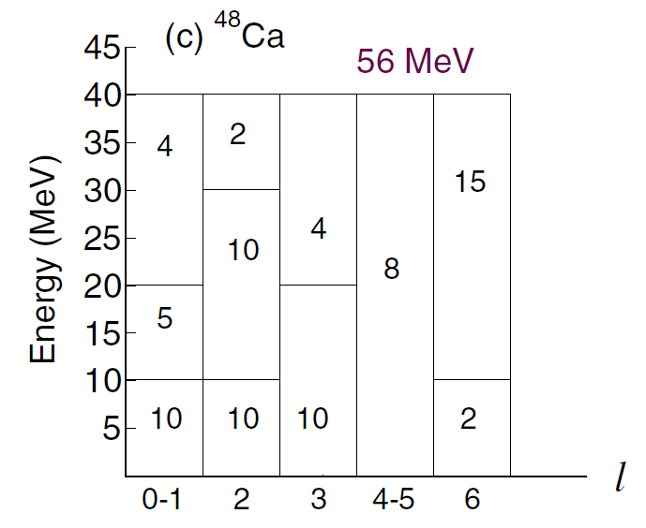
CDCC model space
Upadhyay, Deltuva and Nunes, PRC 85, 054621 (2012)

Slide 37
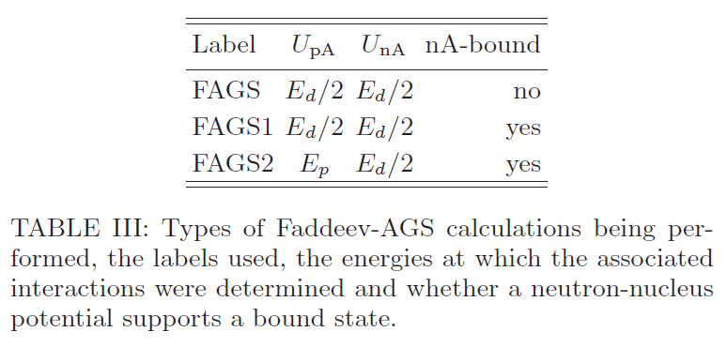
Faddeev calculations: details
Upadhyay, Deltuva and Nunes, PRC 85, 054621 (2012)

Slide 38
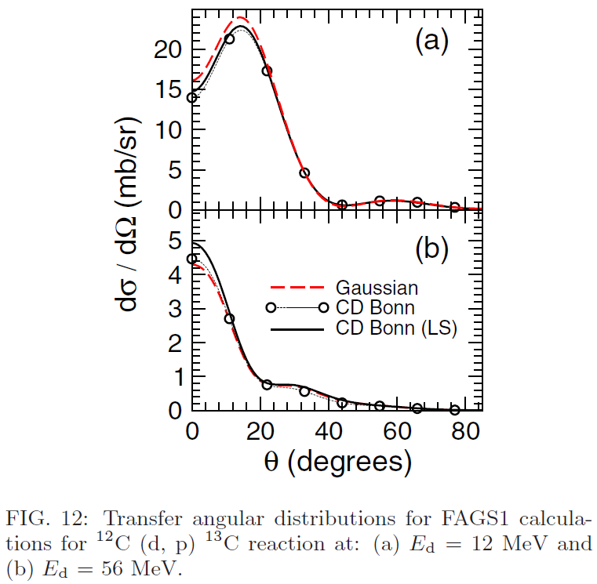
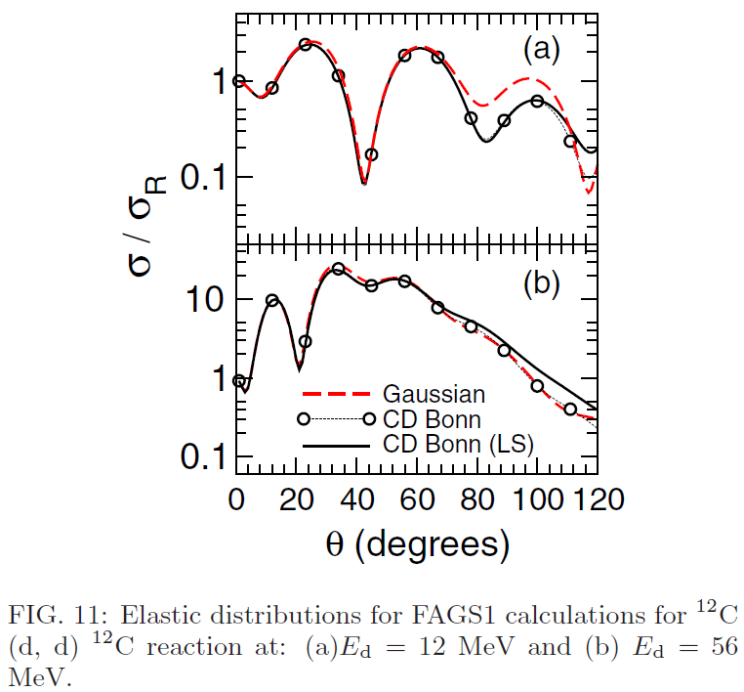
Sensitivity to interactions
At low energies, L dependence of NN interaction important
At high energies, spin-orbit in optical potential important
Upadhyay, Deltuva and Nunes, PRC 85, 054621 (2012)

