Slide 1
Extracting structure information from data
Filomena Nunes
Michigan State University
In collaboration with Anissa Bey (UT),
Neelam Upadhyay (MSU) and Kate Jones (UT).
TORUS collaboration meeting, June 2012

Slide 2
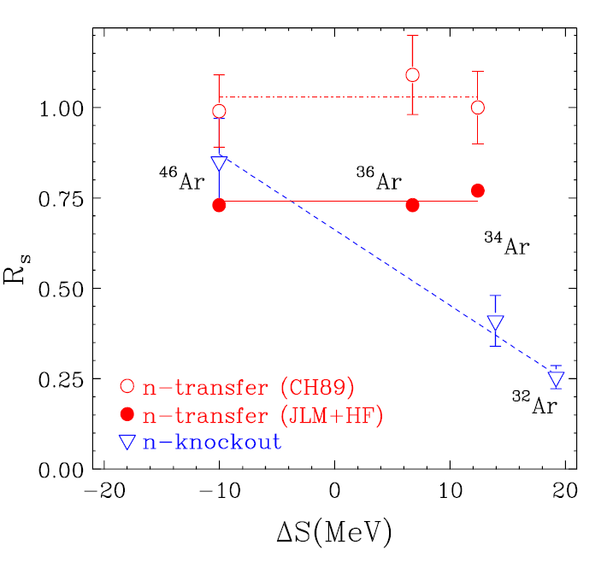
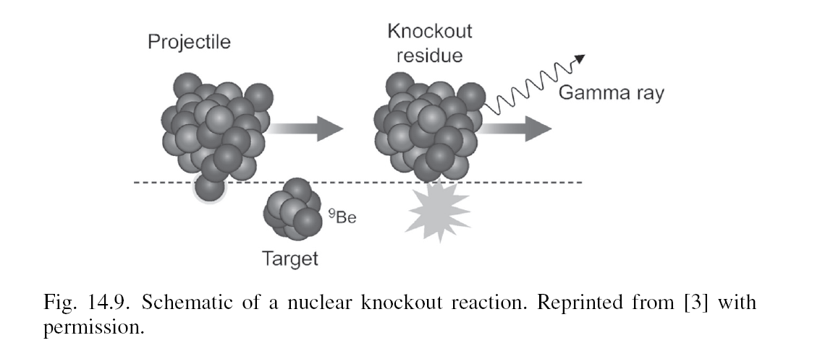
error bar on extracted structure from theory
[Jenny Lee et al, PRL 2009]
[Gade et al, PRL 93, 042501]

Slide 3
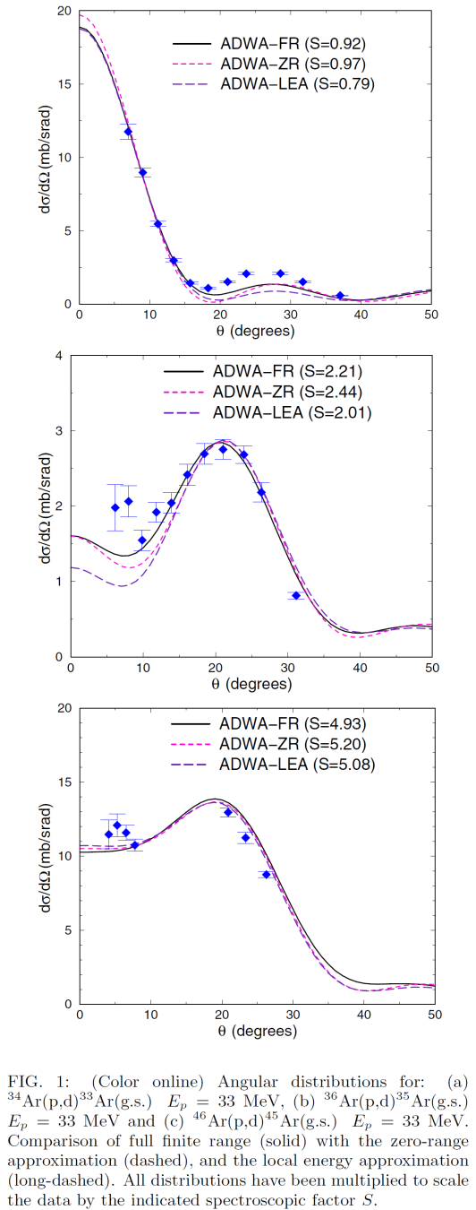
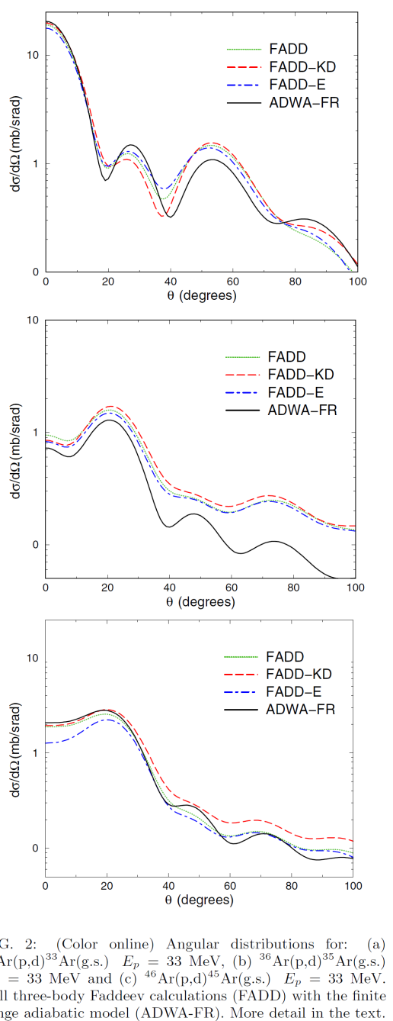
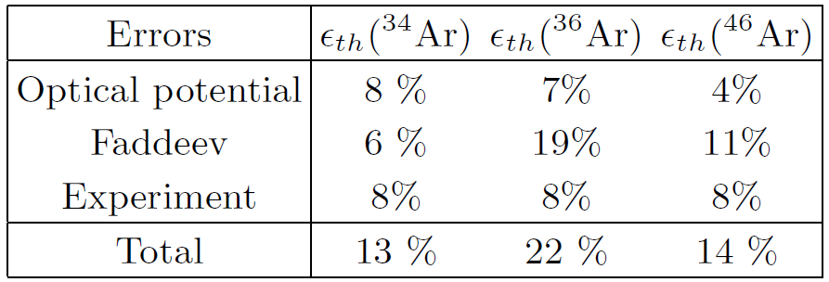
transfer data for Ar isotopes
finite range adiabatic methods are used to obtained spectroscopic factors
Faddeev calculations are used to determined error in reaction theory
[FN, Deltuva, Hong, PRC83, 034610 (2011)]

Slide 4
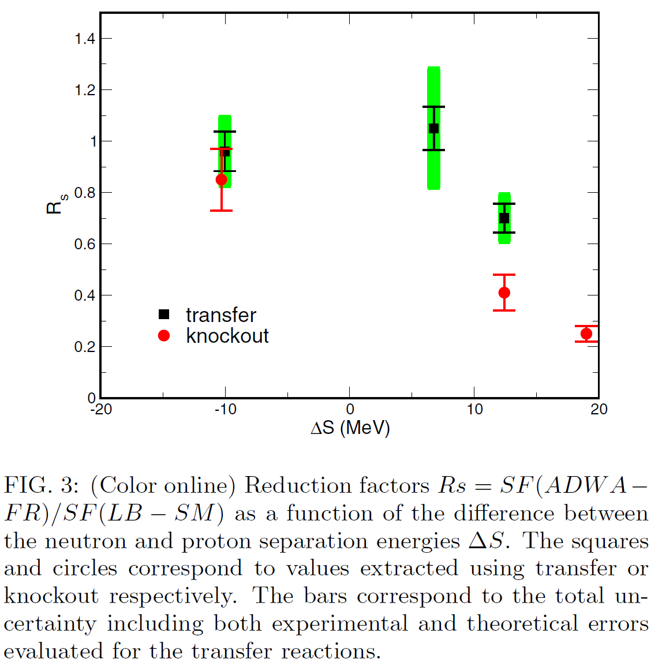
transfer versus knockout
[Jenny Lee et al, PRL 2009]
[Gade et al, Phys. Rev. Lett. 93, 042501]
[FN, Deltuva, Hong, PRC83, 034610 2011]

Slide 5
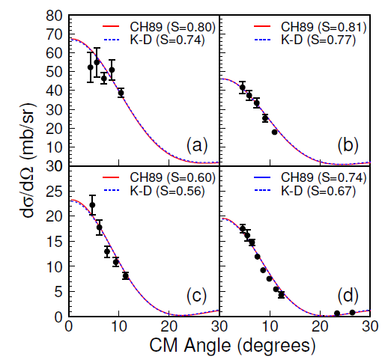
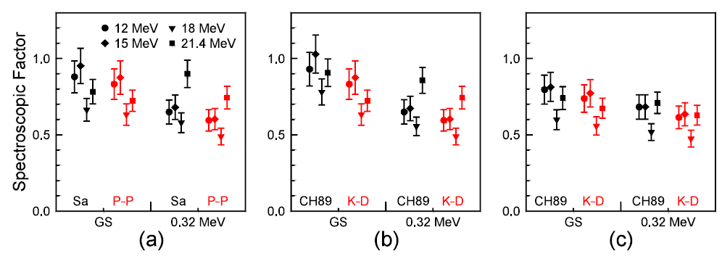
transfer: DWBA versus ADWA
¹⁰Be(d,p)¹¹Be @ 12-21 MeV
DWBA
entrance channel
DWBA
exit channel
ADWA
Schmitt et al, PRL 108, 192701 (2012)

Slide 6
Re-analysis of ¹⁰Be(d,p)¹¹Be data
  error bars on spec. factors only from experiment
  need better understanding of errors associated with ADWA
  elastic scattering data analysis disconnected from (d,p)
  still inelastic data …

Slide 7
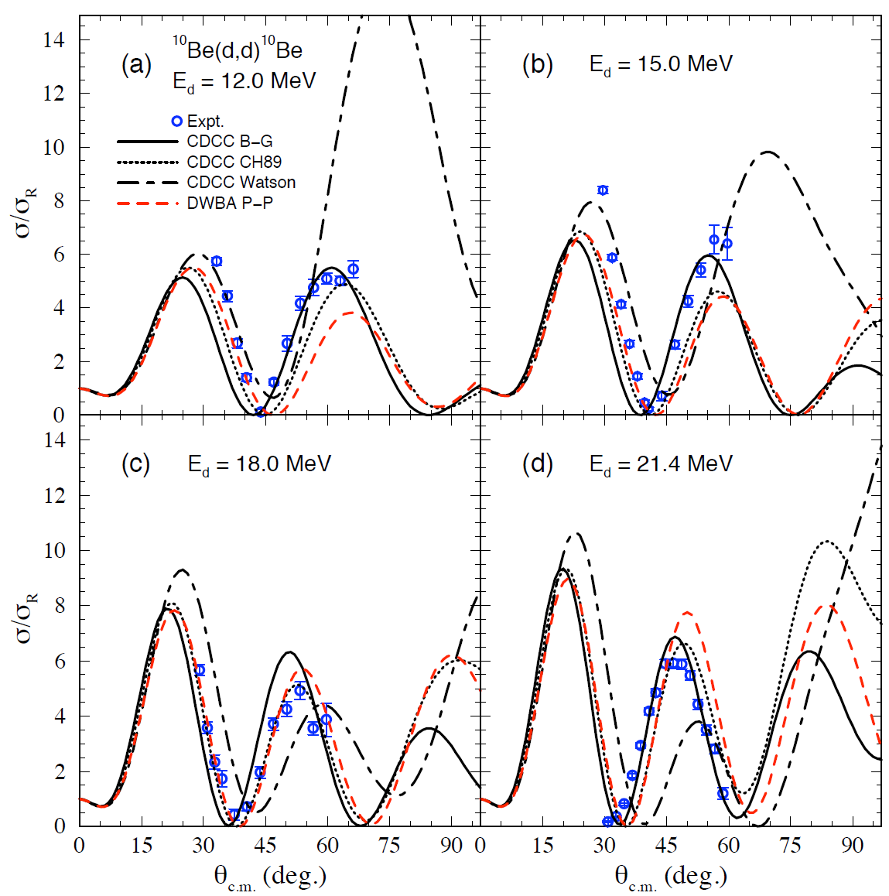
CDCC: choice of nucleon optical potentials
Bey, Upadhyay, Nunes and Jones, prepar.

Slide 8
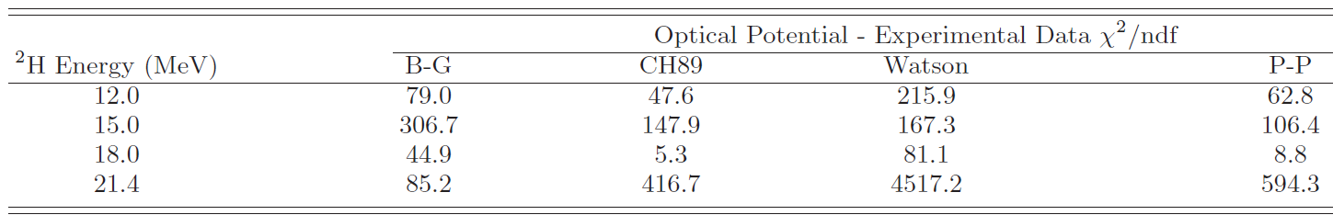
Elastic scattering: Chi^2
CH89 offers best fit with the exception of highest energy
BG offers best overall match
Bey, Upadhyay, Nunes and Jones, in preparation

Slide 9
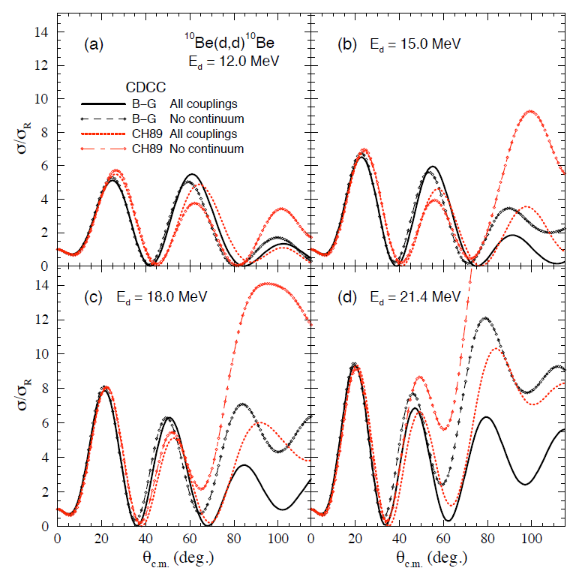
Elastic scattering: continuum effects
Bey, Upadhyay, Nunes and Jones, in preparation

Slide 10
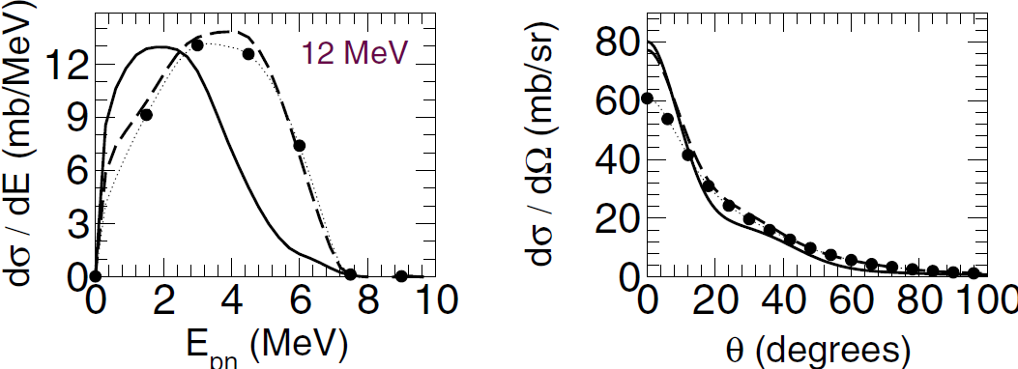
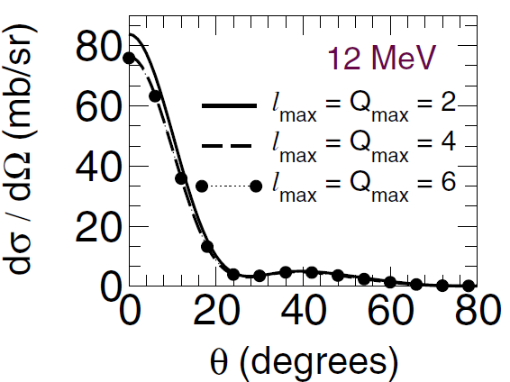
CDCC: convergence check
breakup
transfer
Bey, Upadhyay, Nunes and Jones, in preparation

Slide 11
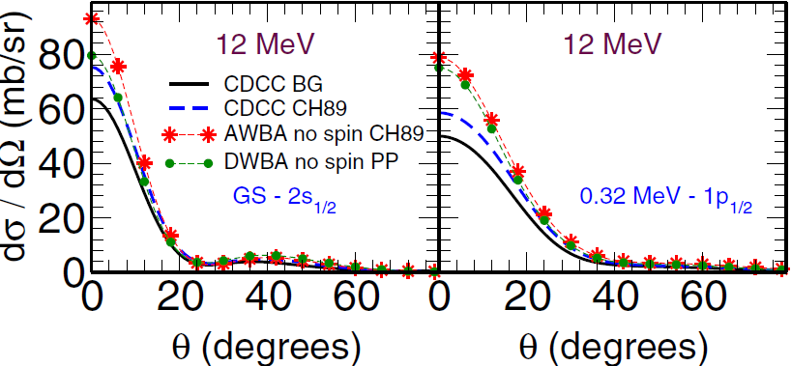
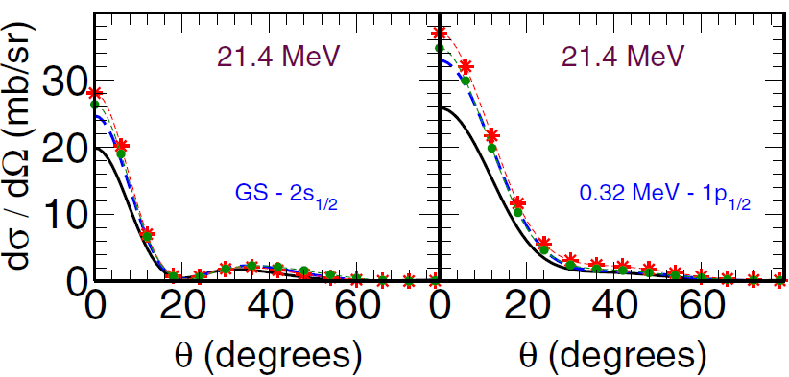
Comparing CDCC, ADWA, DWBA for (d,p)
Bey, Upadhyay, Nunes and Jones, in preparation

Slide 12
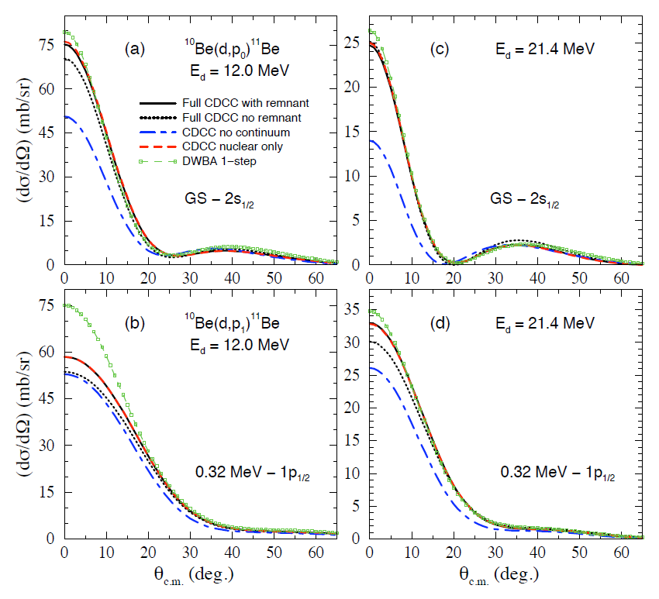
Reaction mechanism
Bey, Upadhyay, Nunes and Jones, in preparation

Slide 13
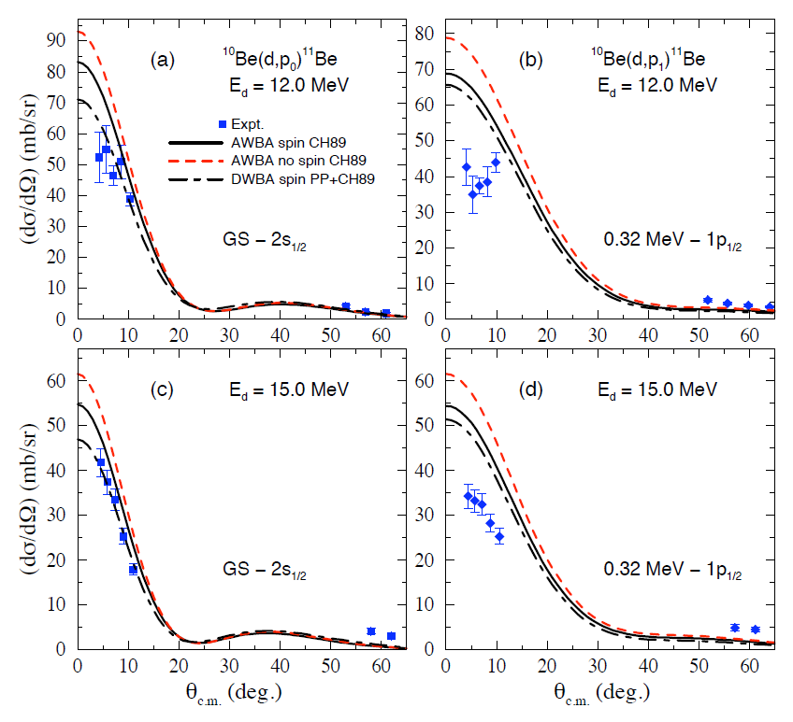
Comparing (d,p) to data: with spin
Bey, Upadhyay, Nunes and Jones, in preparation

Slide 14
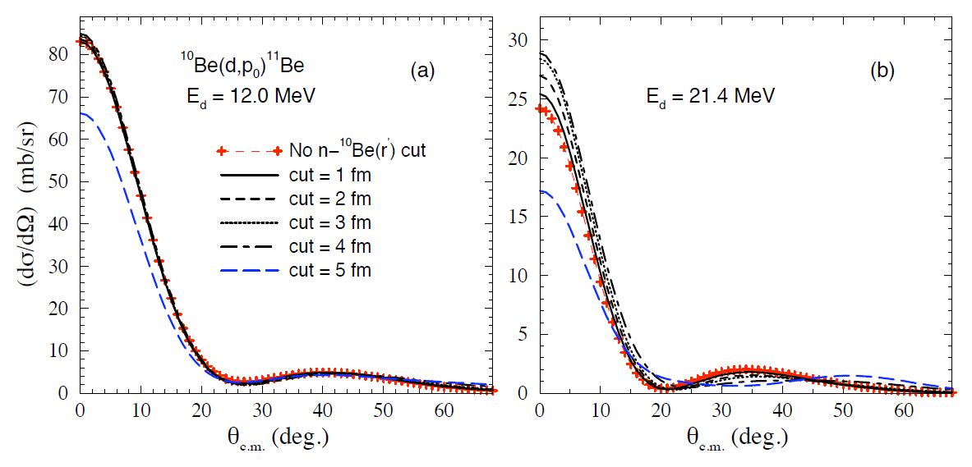
Combined method: ANC and SF
ANC
SF
Bey, Upadhyay, Nunes and Jones, in preparation

Slide 15
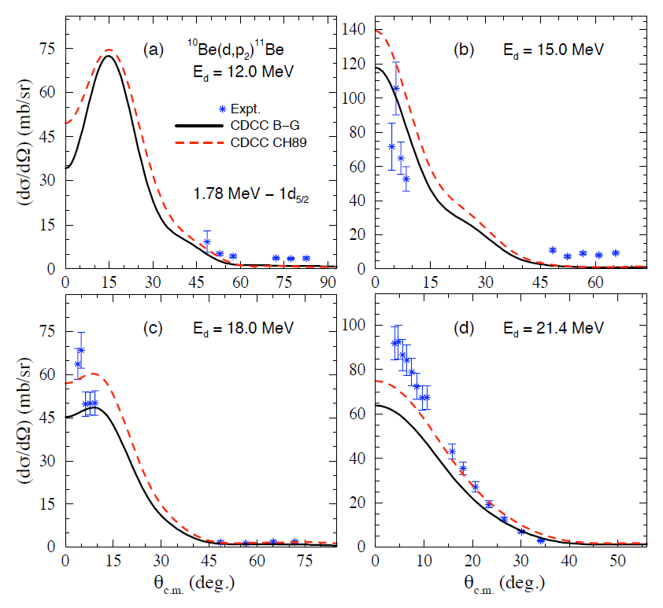
Transfer to the continuum
Bey, Upadhyay, Nunes and Jones, in preparation

Slide 16
More data to come…
¹¹Be(d,p)¹⁰Be around 5 MeV/u: Spokesperson Fred Sarazin, to run in TRIUMF in July
⁵⁶Ni(d,n)⁵⁷Cu around 70 MeV/u: Spokesperson Phil Woods, NSCL PAC 2012
⁸⁶Kr(d,p)⁸⁷Kr around 70 MeV/u: Spokesperson Jolie Cizewski, NSCL PAC 2009
Bey, Upadhyay, Nunes and Jones, in preparation

Slide 17

thankyou!
our group at MSU: Ngoc Nguyen, Muslema Pervin,
Luke Titus, Neelam Upadhyay
collaborators:
Anissa Bey and Kate Jones (Univ. Tennessee)
June Hong(MSU), Arnas Deltuva (Lisbon),
TORUS collaboration: Charlotte Elster (Ohio),
Akram Mukhamedzhanov (Texas A&M),
Ian Thompson (LLNL), Jutta Escher (LLNL)
and Goran Arbanas (ORNL)
Antonio Fonseca (Lisbon), Pierre Capel (Brussels)
Ron Johnson and Jeff Tostevin (Surrey),
This work was supported by DOE-NT, NNSA and NSF

Slide 19
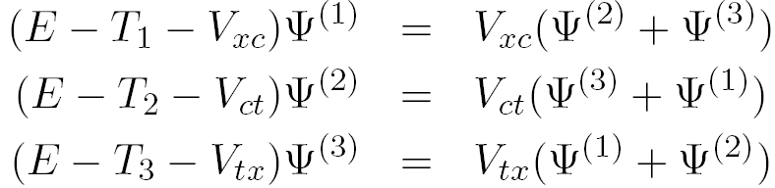
reaction methods: CDCC versus Faddeev formalism
CDCC Formalism
Faddeev Formalism

Slide 20
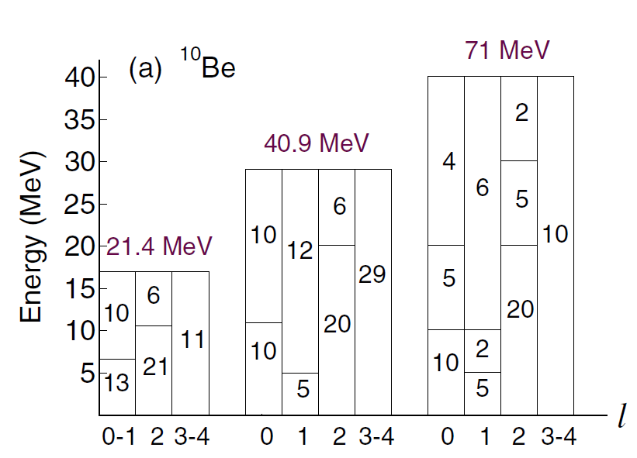
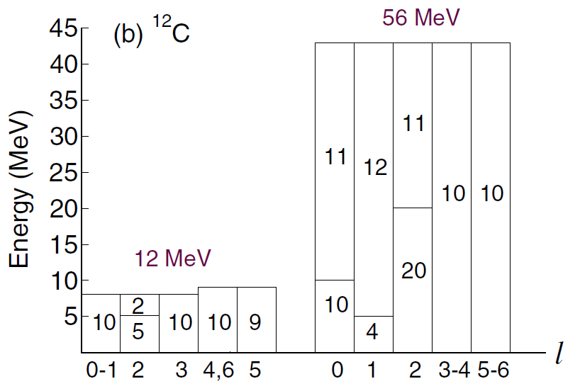
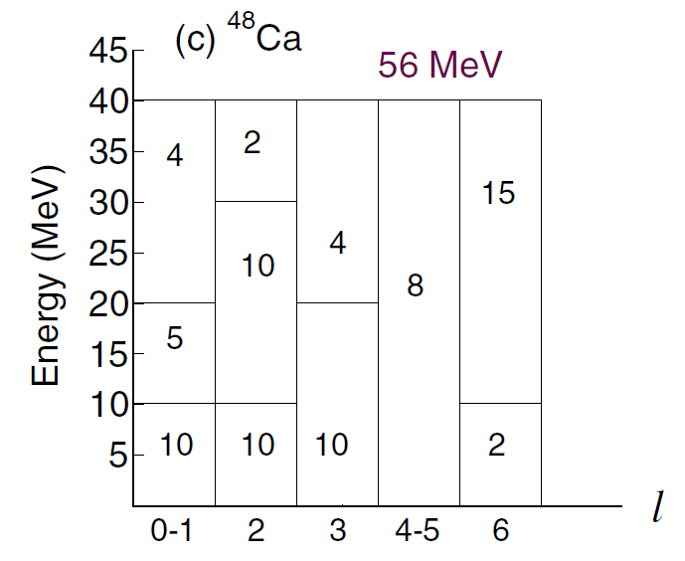
CDCC model space
Upadhyay, Deltuva and Nunes, PRC 85, 054621 (2012)

Slide 21
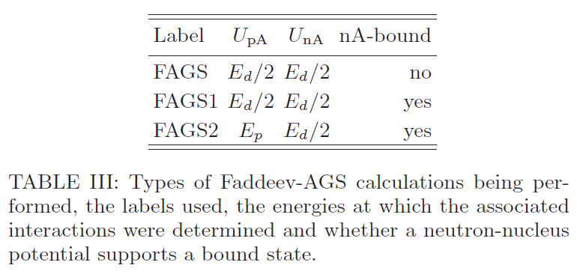
Faddeev calculations: details
Upadhyay, Deltuva and Nunes, PRC 85, 054621 (2012)

Slide 22
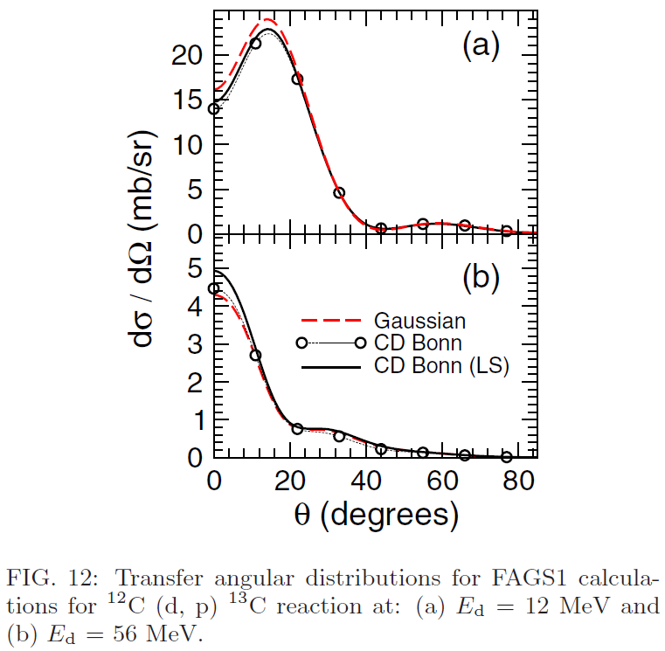
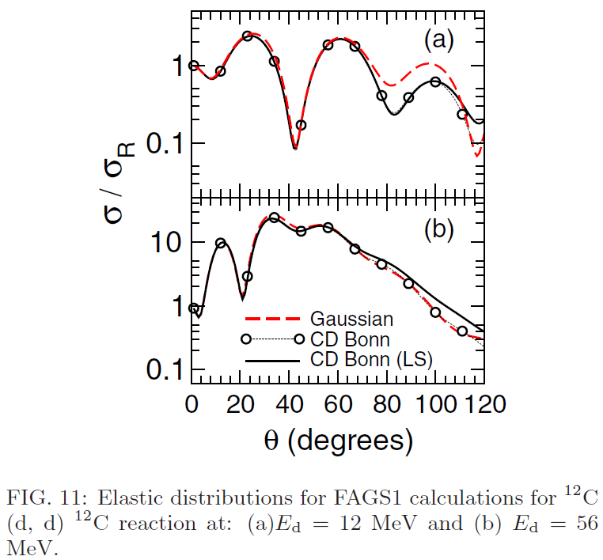
Sensitivity to interactions
At low energies, L dependence of NN interaction important
At high energies, spin-orbit in optical potential important
Upadhyay, Deltuva and Nunes, PRC 85, 054621 (2012)

